Slide 1


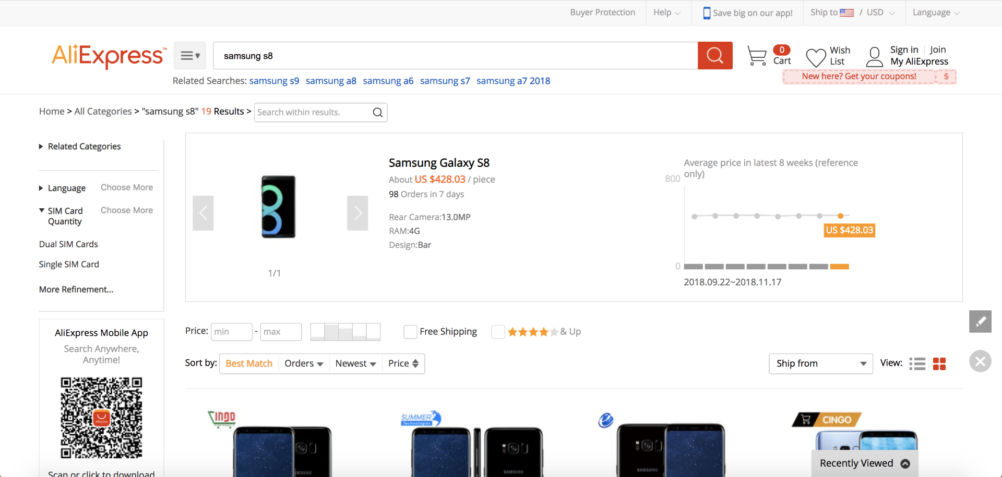
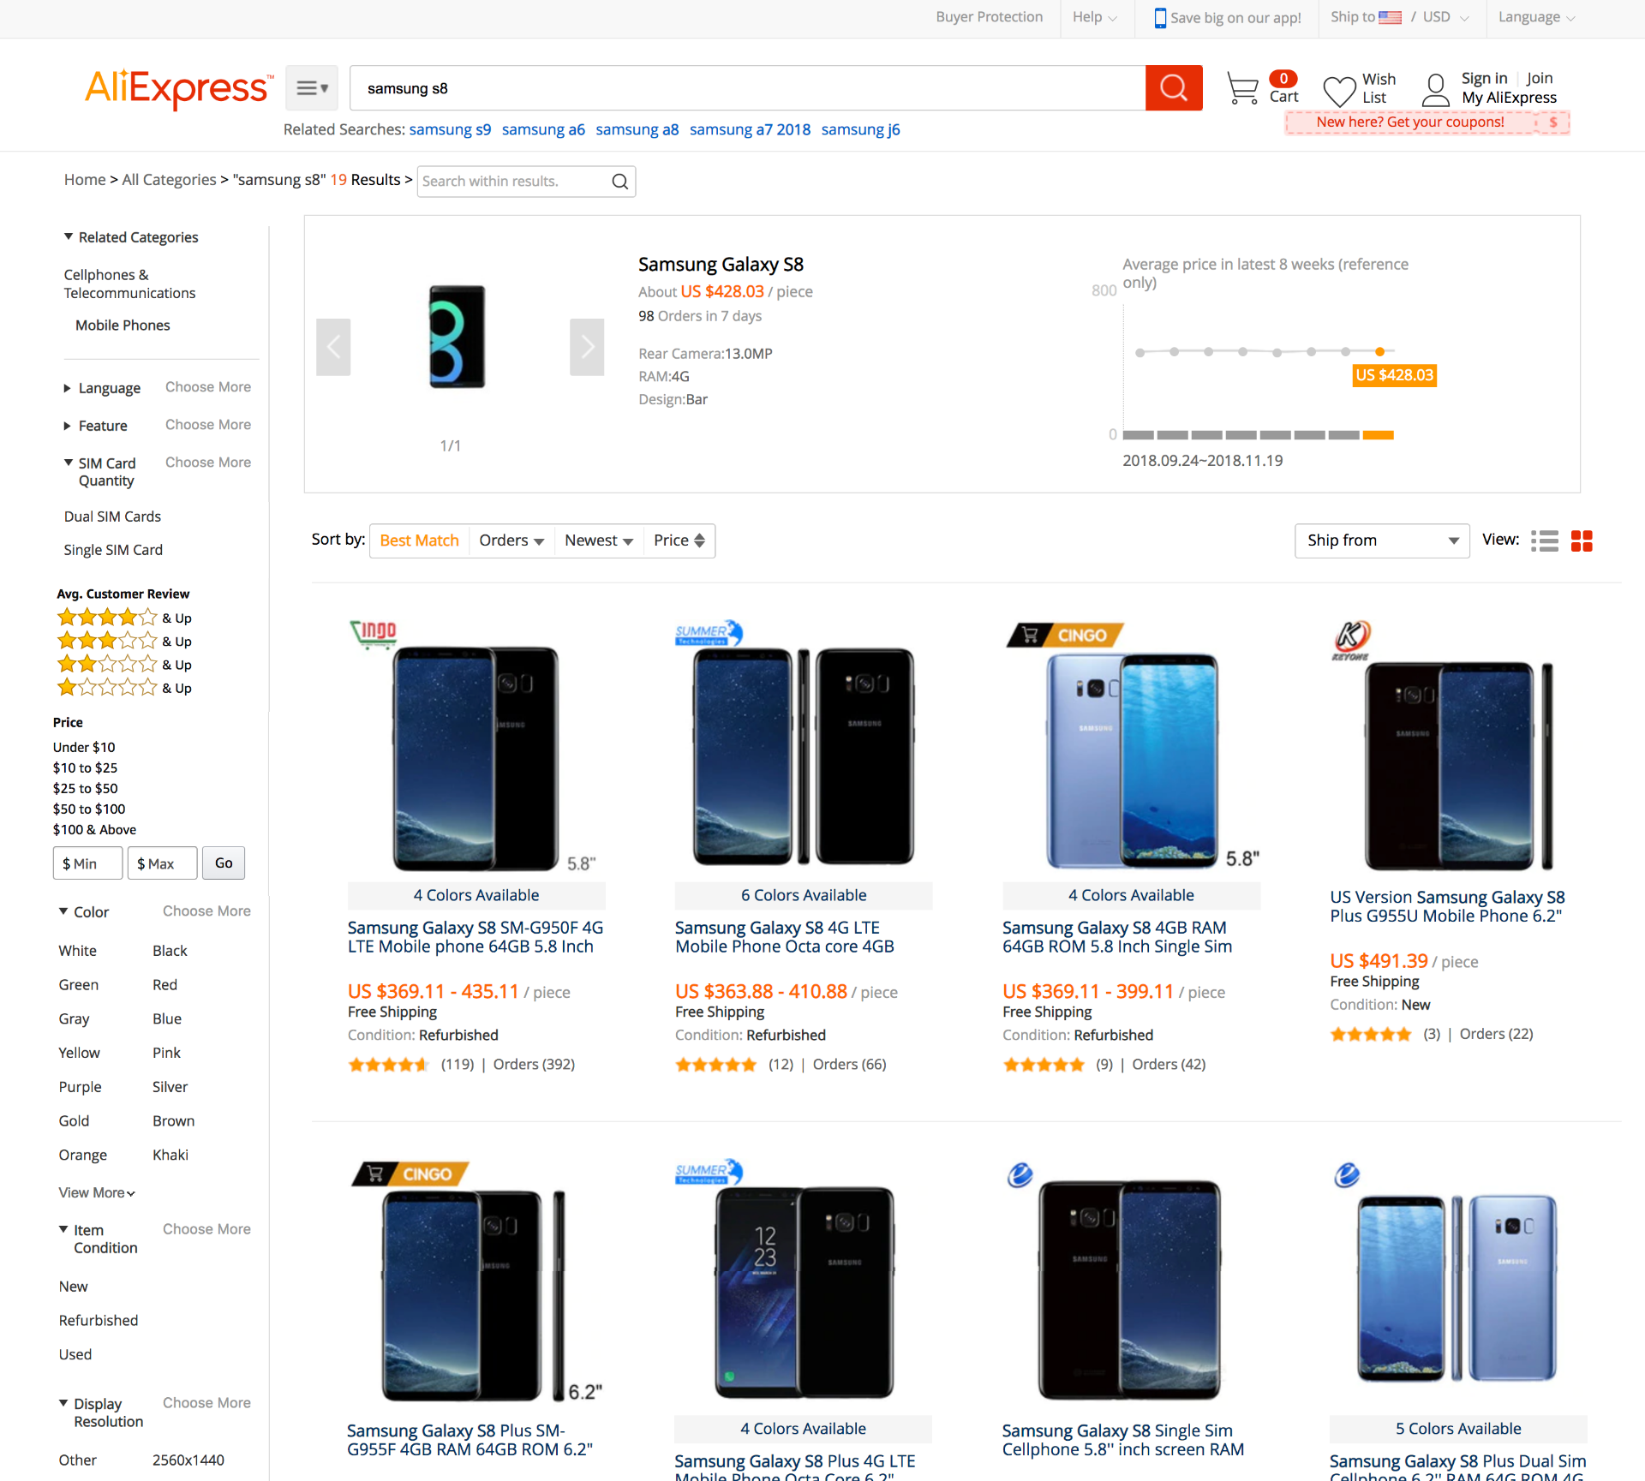


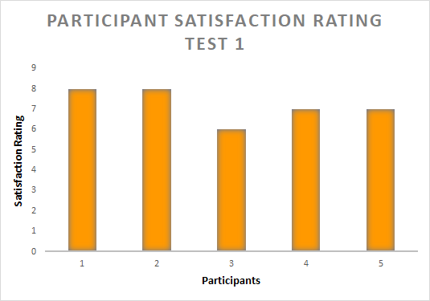


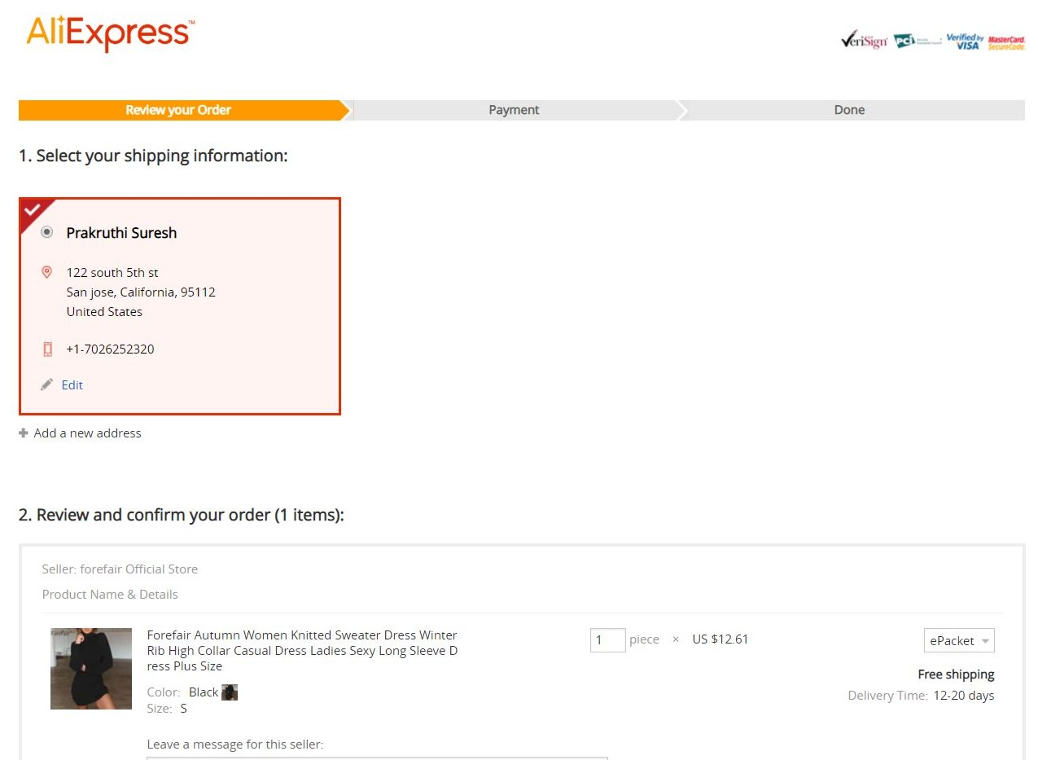
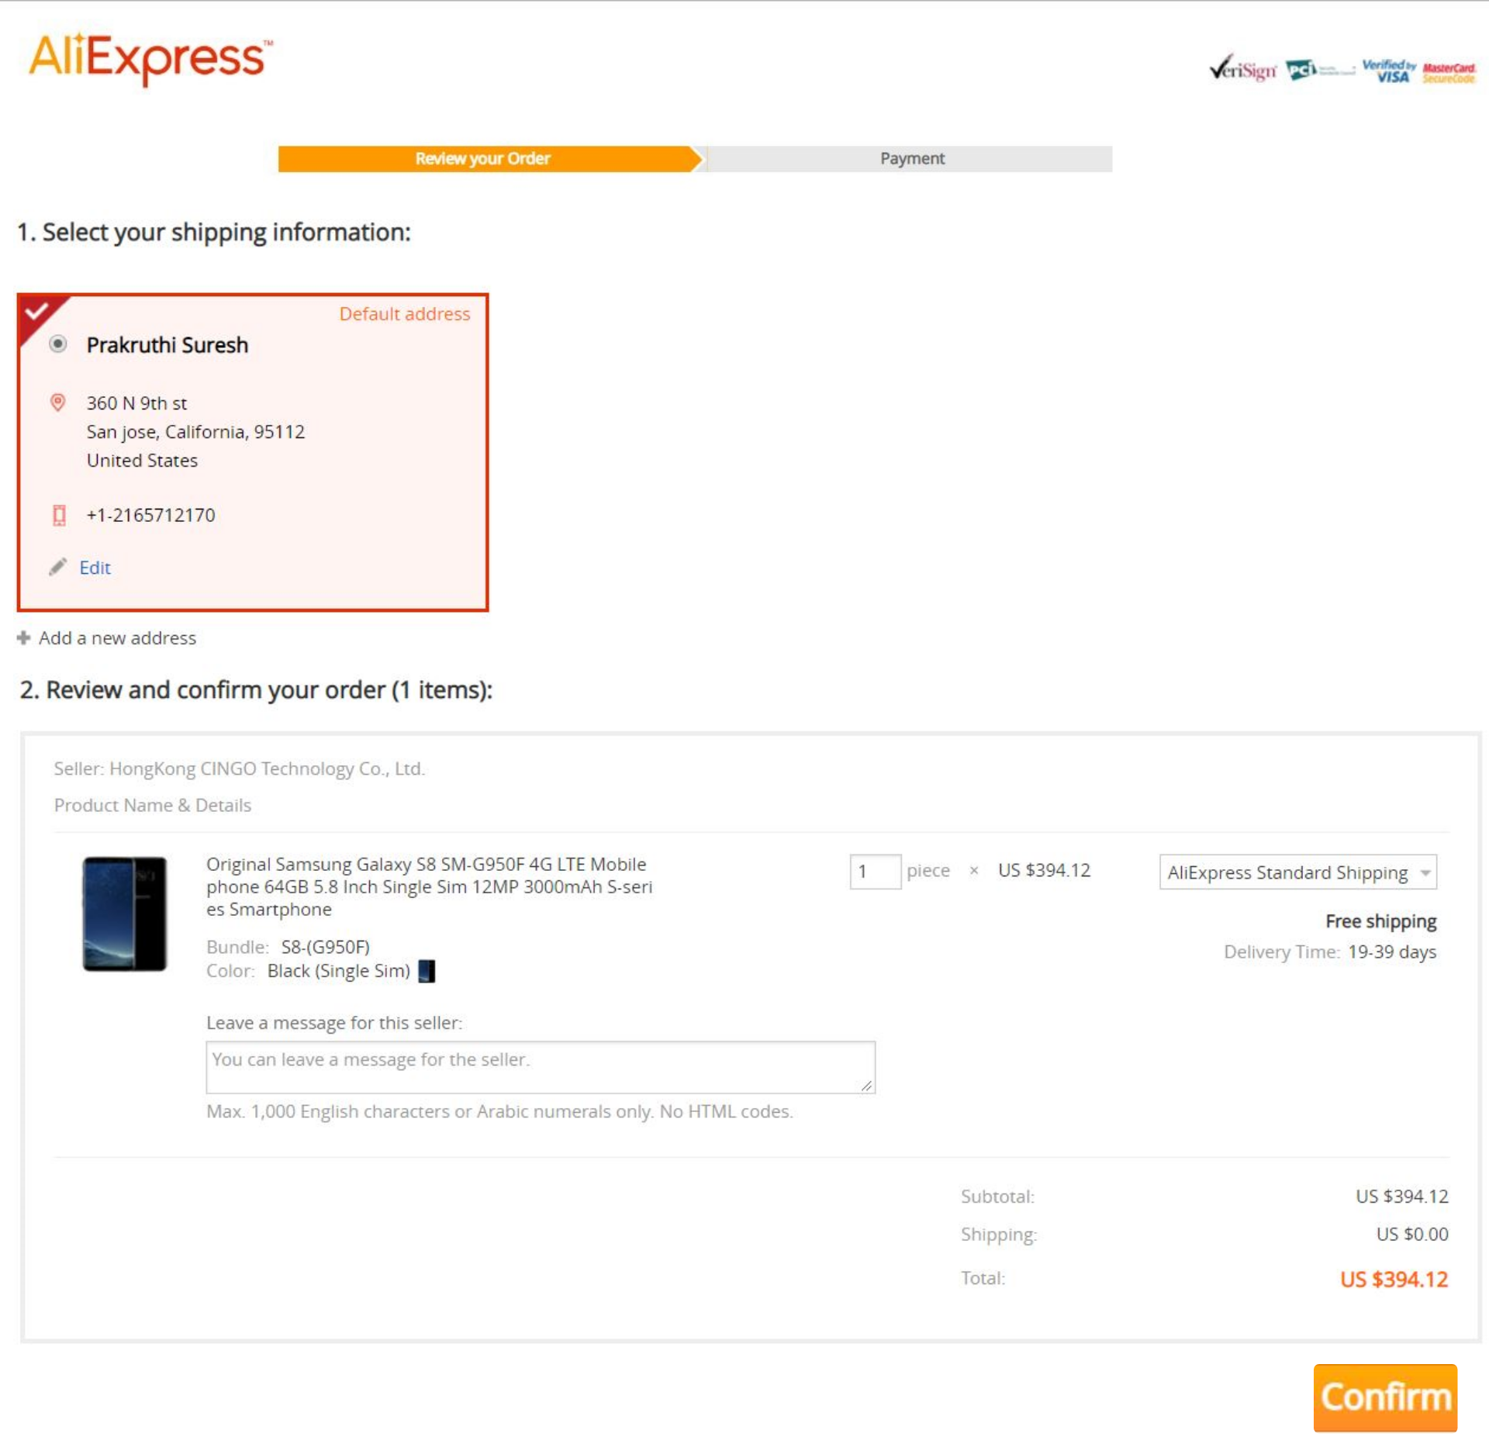
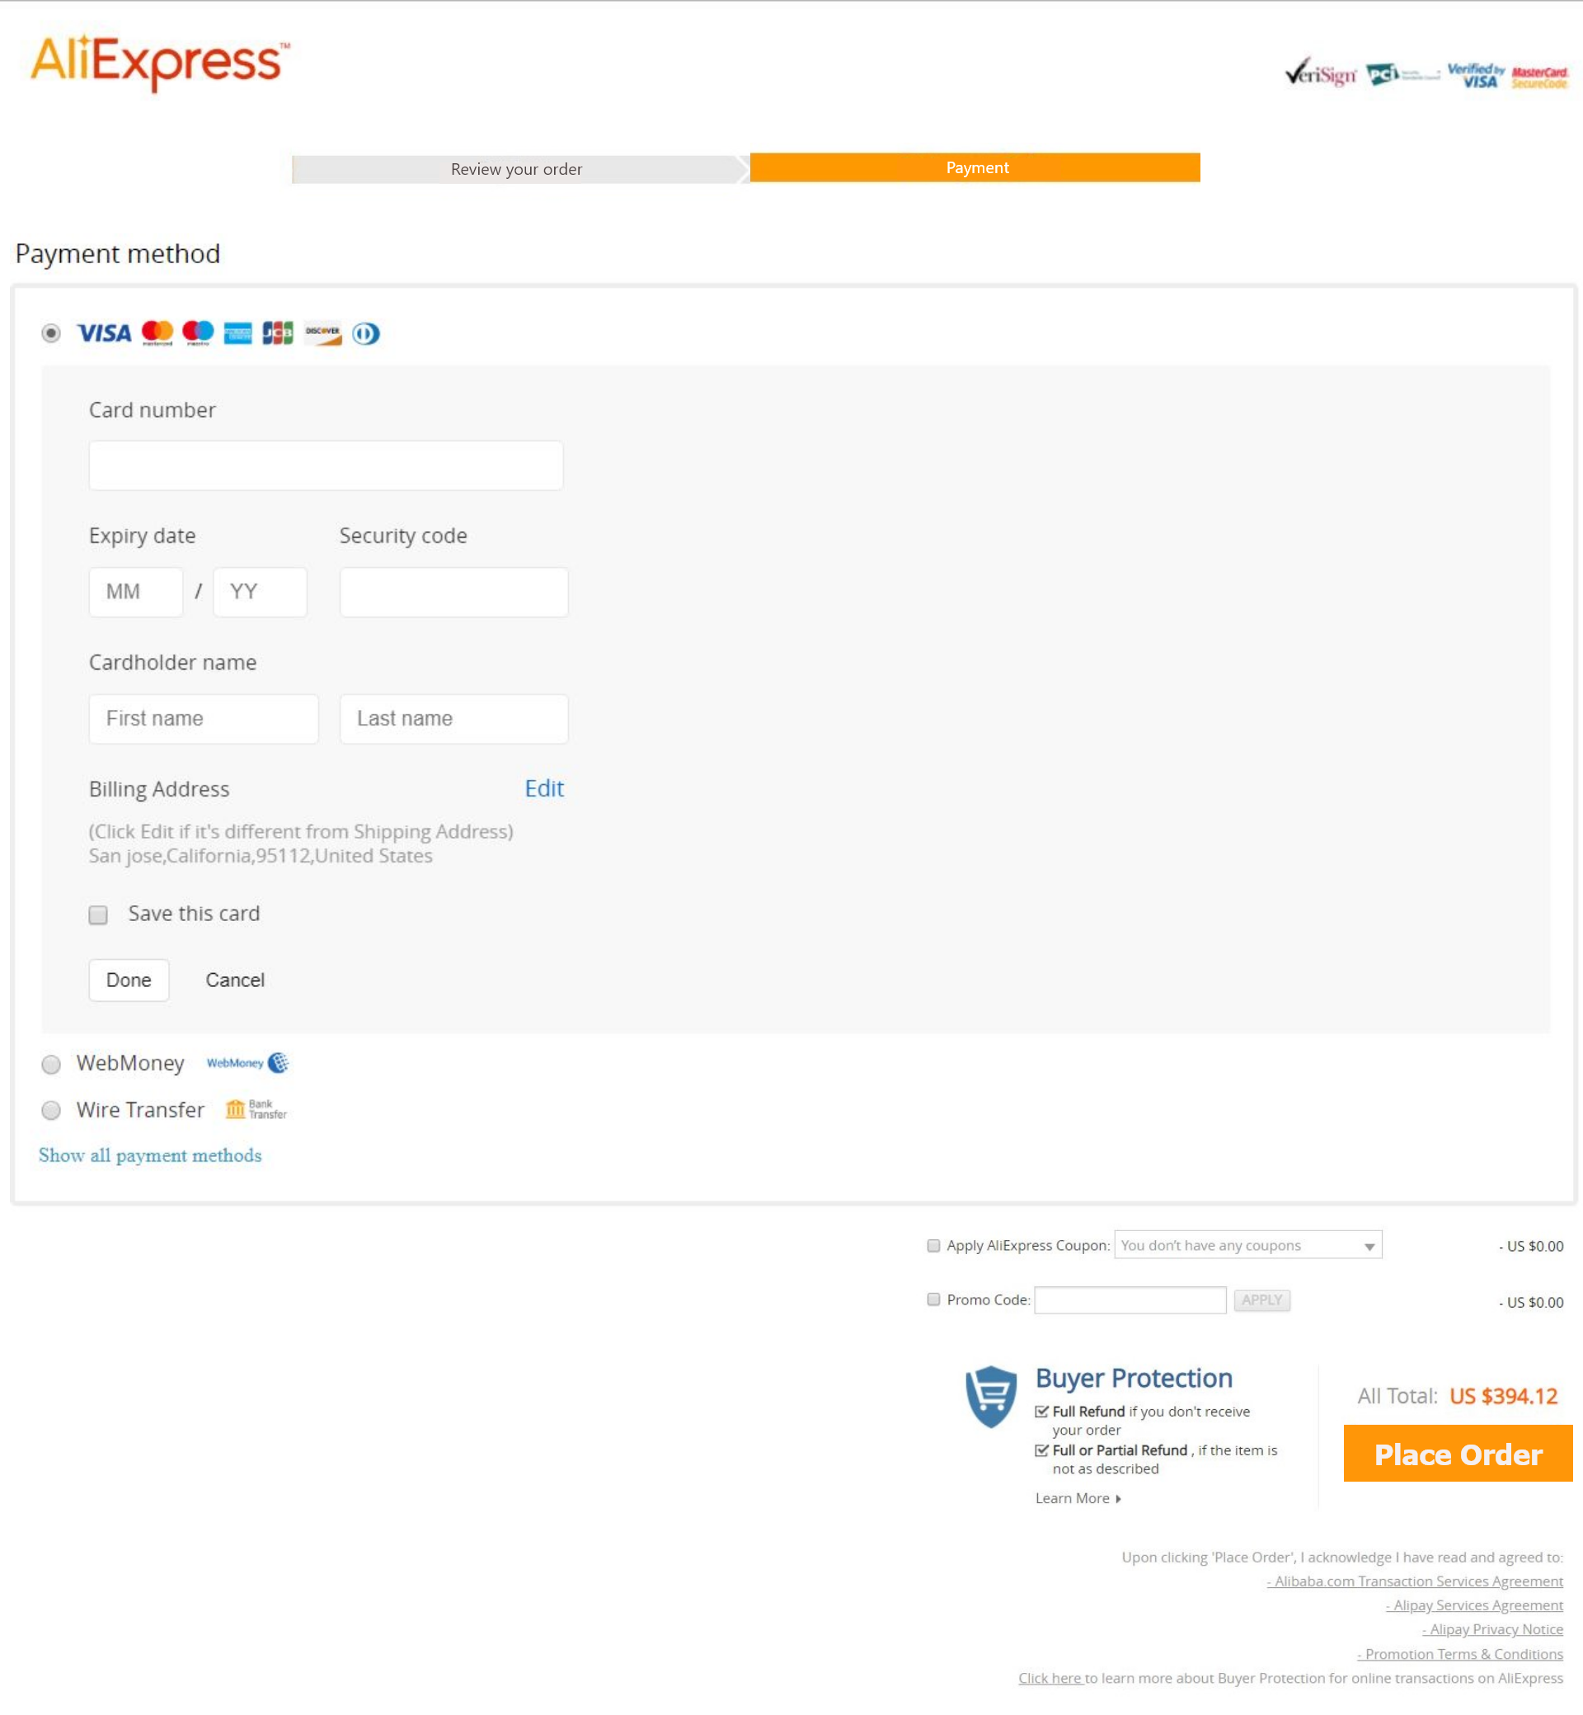
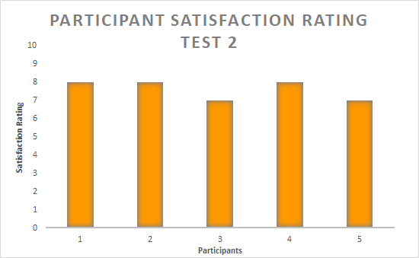
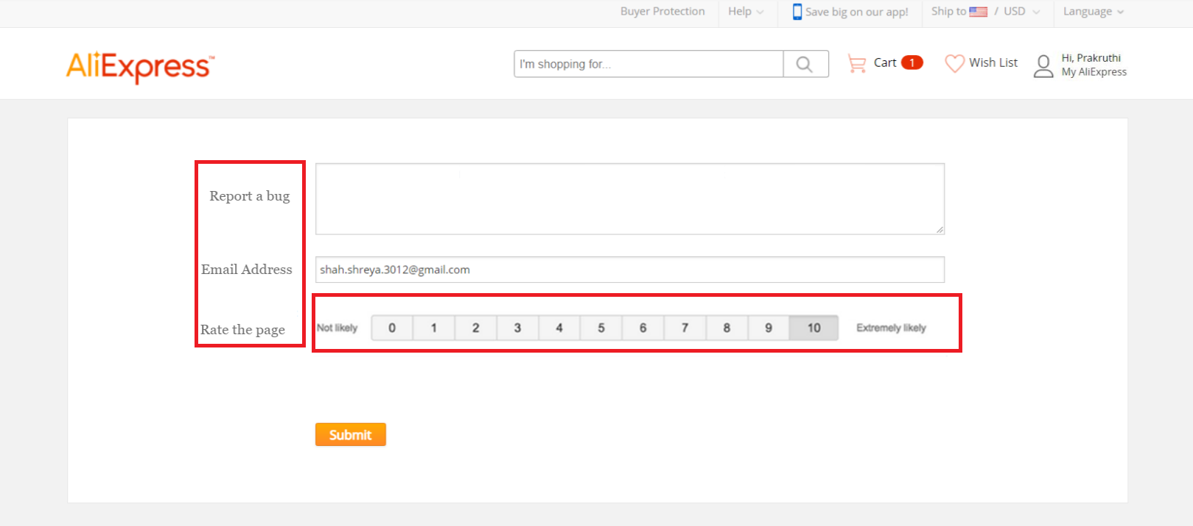
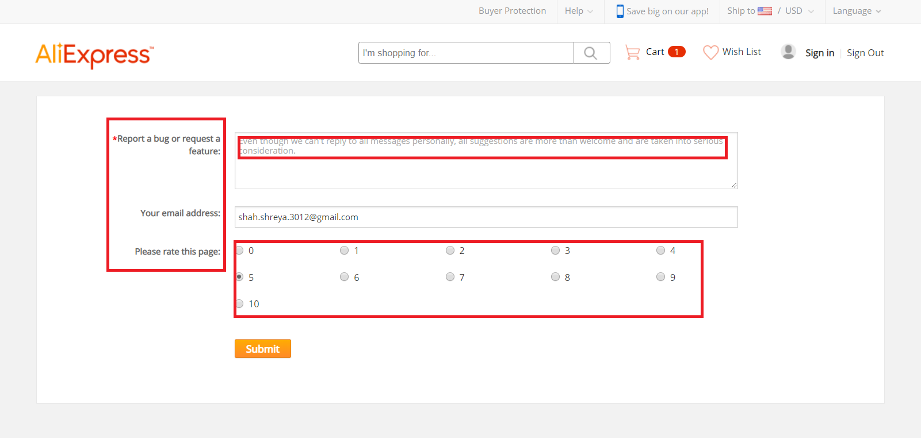
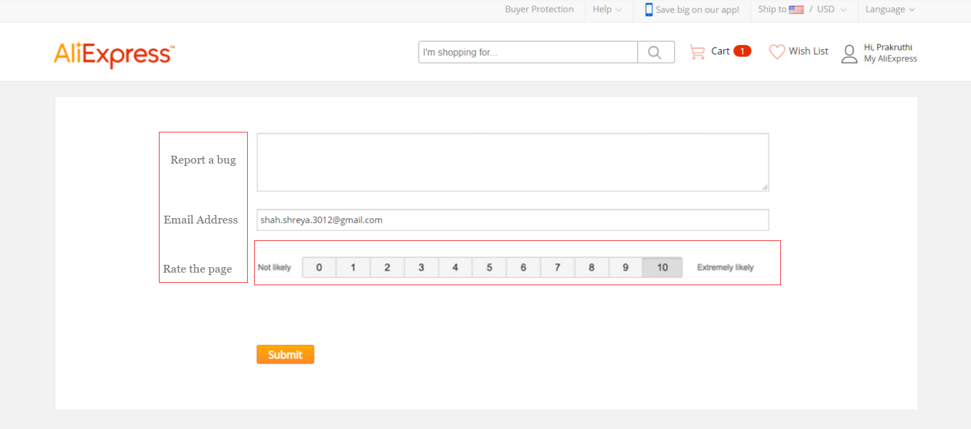
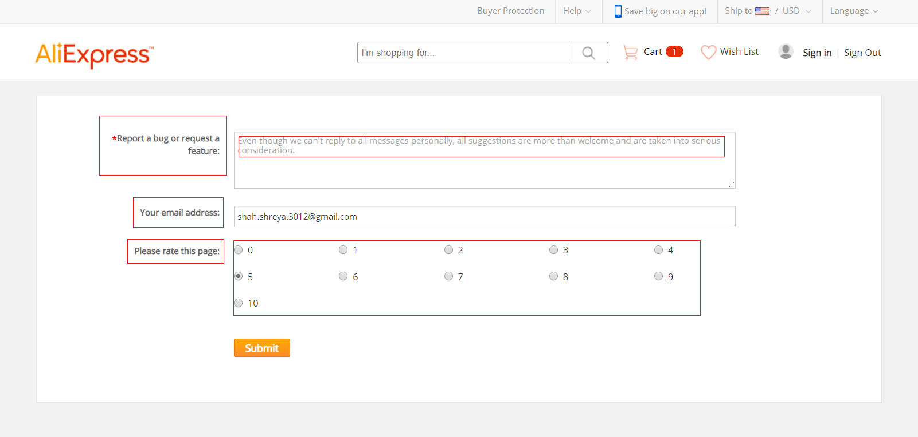
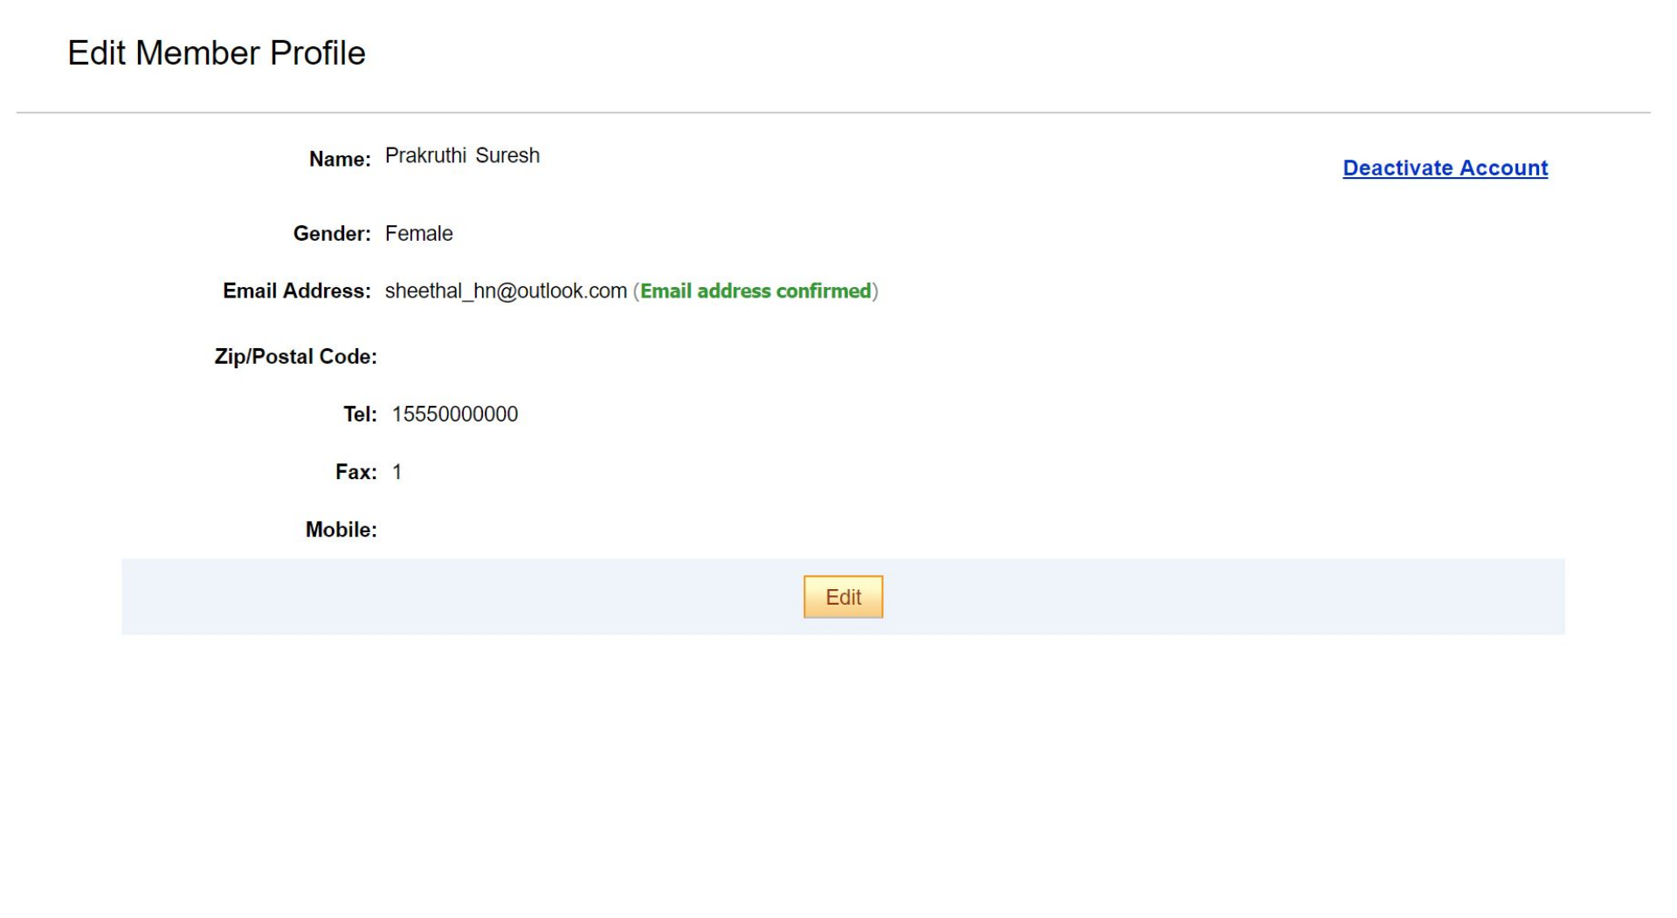
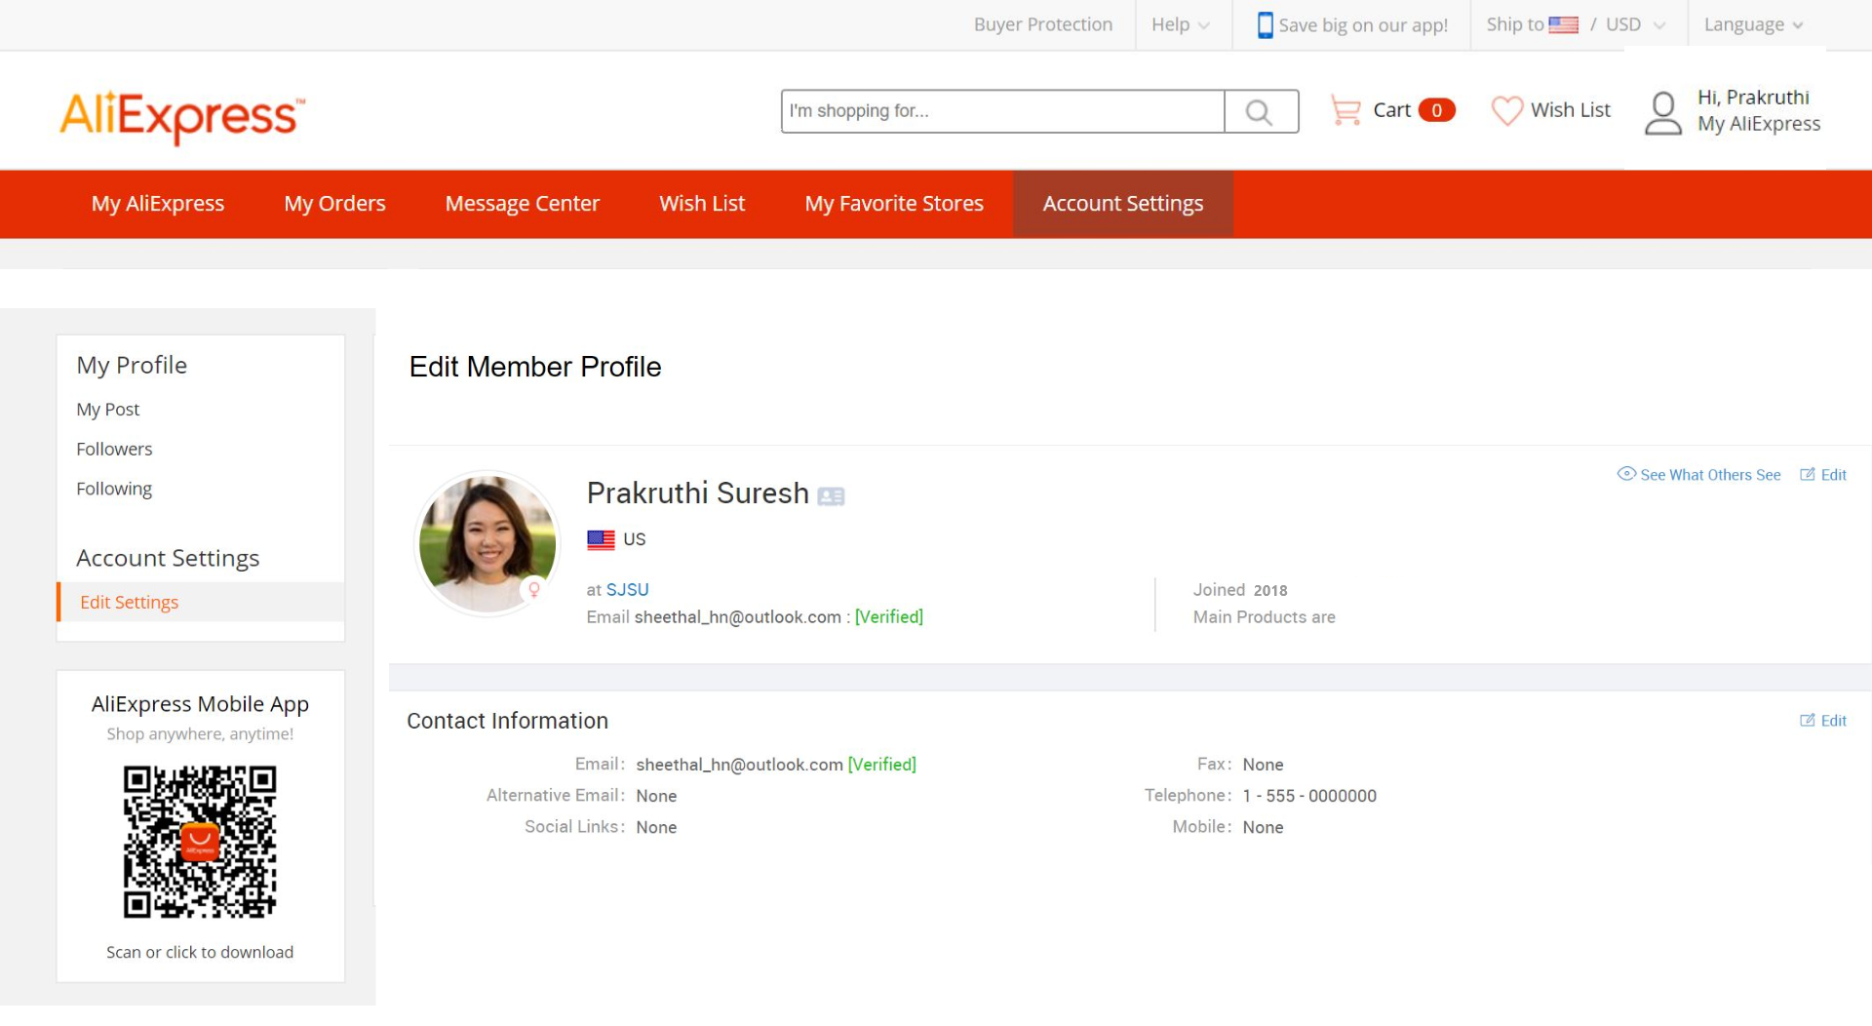
AliExpress Web App Redesign
Mohit Shah, Prakruthi Suresh, Sheethal Nagaraja, Shreya Shah
Introduction
Redesign
Results
AliExpress is an e-commerce portal that enables businesses or individuals to sell their products directly to consumers. It allows users to place and track their orders, request refunds, obtain discounts etc.
We evaluated the interface for tasks such as searching, placing order and managing account.
Improvements based on engineering psychology and human-computer interaction principles and that meet user expectations and needs were made.
Some notable differences in results were found between the two versions of the interfaces.
The average satisfaction rating for the previous interface was 7 whereas that for the redesigned interface was 7.6.
User Profile
Jane Sawyer
Tom Smith
Gestalt’s Principles - Added a set of filters on the left side bar which open up after clicking ‘More Refinement’. Keeping filters together is good grouping and makes it easier for user to narrow down results.
A hotel receptionist who is an avid online shopper.
An engineer who only shops online when he is very busy.
Goals:
Browse through products, compare prices and reviews among different sellers, and place and track order.
Frustrations with older version of app:
Too many filters
Unable to complete placing order.
Goals:
Able to search for products and place order quickly.
Able to save stores and sellers for future orders.
Frustrations with older version of app:
Too many product variations
No fast delivery option
Better feedforward - progress bar matches with information on the page.
All participants completed the task with redesigned version and the average task completion time reduced from 6 to 5 minutes.
Methods
Changed Rating scales for better and obvious understanding - Top down Principle
Conclusion
To obtain data about user preferences and pain points, we conducted user testing with the Think Aloud Technique. A survey was also administered to the participants to gather information about their shopping behavior and satisfaction with the interface.
The user testing data provided areas of focus for the redesign of the web app. The design and interactive prototype were created using Adobe XD.
Based on the results of our user testing, we redesigned some features of the interface for better usability. Improvements were made to the organization of filters, mapping of task to progress bar, rating scale and consistency of the website.
Users showed improved satisfaction and reduced task completion time using the redesigned version of the web app.
Redesigned page to make it consistent with the website - Consistency and Standards

